Slide 1
IBM University Engagement Project Submission
“Exploring the Power of Agentic AI with IBM Cloud and Orchestrate”

Slide 2

Project Tile – Social Media Agent
Domain of Project – Social Media Analytics
Student Name | Recent Passport Photo | Email ID | Mobile number [WhatsApp]
Ankita Anant Panchal |  | ankitapanchal9090@gmail.com | 8459060518

Slide 3
Problem Statement -
Problem Statement No.10: Social Media Agent
The Challenge
Brands, influencers, and organizations struggle to keep up with the fast-paced and fragmented world of social media. Content trends evolve hourly, audience sentiment shifts rapidly, and competitor strategies are difficult to track. Managing multiple platforms often leads to scattered insights, missed engagement opportunities, and ineffective campaigns. The challenge is not only to collect social media data but also to analyze, predict, and recommend actions in real time.
The Objective
Build an agentic Al application that acts as an intelligent social media companion. The solution should:
1. Fuse Multichannel Data: Collect and synthesize content, comments, hashtags, and competitor posts from platforms like X, LinkedIn, Instagram, and Facebook into unified insights.
2. Enable Multimodal Interaction:- Accept user inputs (text, images, or voice prompts) and generate creative post drafts, captions, or campaign ideas aligned with brand tone.
3. Create a Predictive & Agentic Layer: Forecast trending hashtags, audience sentiment shifts, and competitor engagement patterns while suggesting the best posting schedules.
4. Visualize Social Media Pulse:- Provide a dashboard with real-time analytics-engagement trends, influencer mapping, sentiment tracking, and campaign performance forecasts.
Tech Stack (Mandatory)
IBM Langflow/IBM Orchestrate + IBM Models

Slide 4
Proposed Solution -
Proposed Solution: AI-Powered Social Media AgentThe proposed solution is a multi-agent AI-powered Social Media Agent built using IBM Orchestrate, IBM watsonx.ai, and IBM Granite Models to help brands, creators, and businesses manage and optimize their social media presence.
The system analyzes social media content, predicts trends, performs sentiment analysis, and generates AI-powered captions, hashtags, and campaign ideas. It provides real-time recommendations for improving engagement and selecting the best posting times.The solution consists of four key agents:Content
Generation Agent – Creates engaging captions, hashtags, and campaign ideas based on user input.Trend & Sentiment Analysis Agent – Detects trending topics and analyzes audience sentiment from social media data.Competitor Analysis Agent – Monitors competitor performance and suggests strategies to improve reach and engagement.Analytics & Recommendation Agent – Visualizes engagement metrics and recommends the best posting schedule and content strategy.
The application includes an interactive dashboard that displays engagement analytics, trend insights, sentiment reports, and campaign performance through easy-to-understand charts and graphs.Overall, the solution delivers an intelligent AI-powered social media assistant that helps users create better content, track performance, and make data-driven marketing decisions.

Slide 5
Technology Used
IBM Orchestrate – Designs and automates the multi-agent workflow for social media analysis and content generation.
IBM Granite Model (Granite-4.0-8B-Instruct) – Generates captions, hashtags, campaign ideas, and provides intelligent recommendations.
IBM watsonx.ai – Hosts and manages the AI models for content generation, sentiment analysis, and predictive insights.
IBM Cloud – Provides a secure, scalable, and reliable platform for deploying the AI-powered application.
HTML, CSS, JavaScript & Chart.js – Used to build the responsive web interface, interactive dashboard, and analytics visualizations.

Slide 6
Orchestrate component Used -
1. Chat Input
Accepts user prompts related to social media analysis, content generation, and marketing strategies.
2. IBM watsonx.ai Agent
Processes user input using IBM Granite models to generate captions, hashtags, sentiment analysis, and actionable recommendations.
3. IBM Granite Model
Granite-4.0-8B-Instruct – Used for content generation, trend analysis, and intelligent responses.
4. Chat Output
Displays AI-generated captions, trending hashtags, sentiment insights, competitor analysis, and the best posting strategies.
5. Project Files
index.html, style.css, script.js, data.js, README.md – Handle the UI, styling, application logic, sample data, and project documentation.
6. IBM Technologies Used
IBM Orchestrate
IBM watsonx.ai
IBM Granite-4.0-8B-Instruct

Slide 7
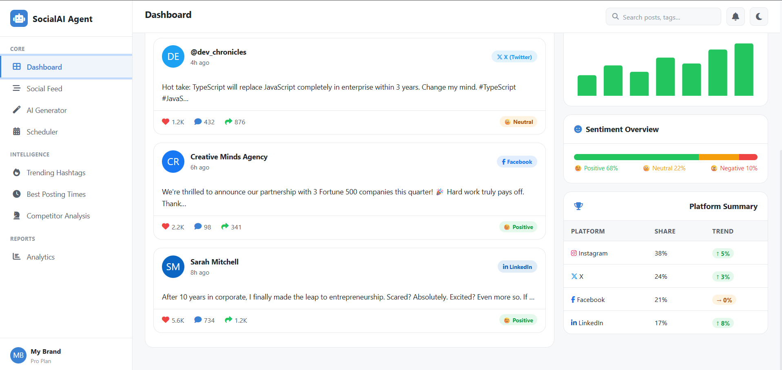
Agent Instructions Screenshot-

Slide 8
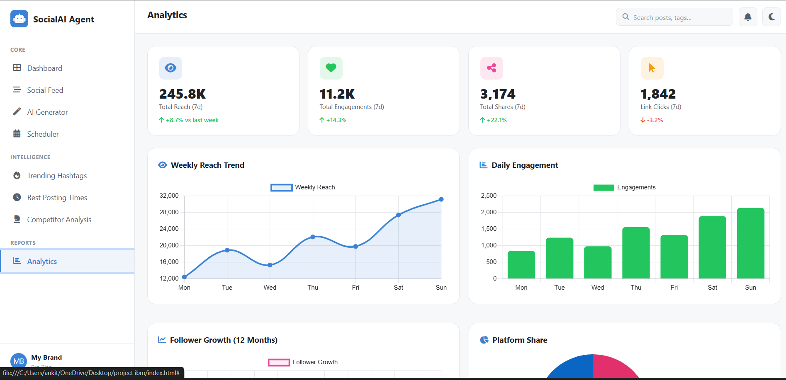

Slide 9
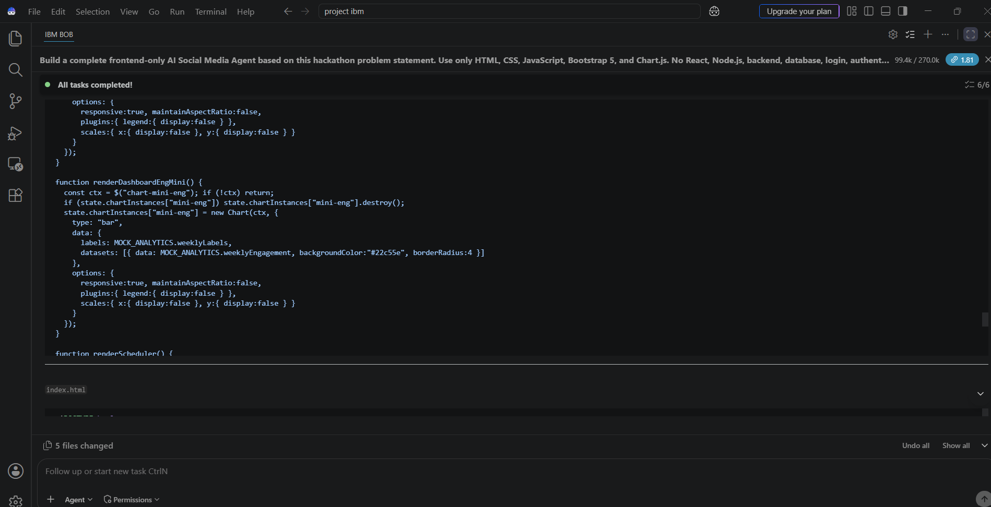
Prompt with output Screenshot:

Slide 10
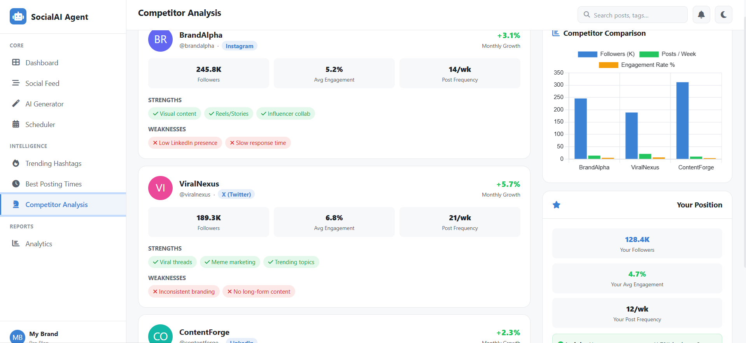

Slide 11

Role of Agentic AI in the solution
Role of Agentic AI in Social Media Agent
Agentic AI enables the Social Media Agent to function as an intelligent, autonomous assistant rather than a simple chatbot. Using IBM watsonx.ai, IBM Granite Models, and IBM Orchestrate, it coordinates multiple AI agents to collect, analyze, and interpret data from platforms like Instagram, X, Facebook, and LinkedIn.
Each agent performs a specific task—such as monitoring social media trends, analyzing audience sentiment, generating captions and hashtags, predicting the best posting time, and providing competitor insights. This multi-agent approach ensures faster, accurate, and data-driven decision-making.
Agentic AI continuously adapts to changing trends and user inputs, providing real-time recommendations, personalized content strategies, and engagement optimization. Overall, it acts as a smart social media assistant that helps brands and creators improve their online presence and campaign performance.

Slide 12
Novelty and Uniqueness
The proposed Social Media Agent stands out by combining Agentic AI, predictive analytics, and intelligent content generation into a single AI-powered platform.
Multi-Agent Intelligence – Multiple AI agents collaborate to analyze trends, generate content, monitor engagement, and provide actionable recommendations.
AI-Powered Content Creation – Automatically generates captions, hashtags, campaign ideas, and CTAs based on the user's topic and audience.
Predictive Social Media Insights – Forecasts trending hashtags, audience sentiment, and the best posting time for maximum engagement.
Real-Time Analytics – Provides live dashboards with engagement metrics, sentiment analysis, and campaign performance using interactive charts.
Competitor Analysis – Compares competitor performance and suggests strategies to improve reach and engagement.
Multimodal Interaction – Supports text and image inputs for content creation and analysis.
Scalable & IBM Powered – Built using IBM watsonx.ai, IBM Granite Models, and IBM Orchestrate, ensuring reliable, intelligent, and enterprise-ready AI workflows.
This makes the solution a smart, adaptive, and proactive AI social media assistant that helps brands and creators optimize their online presence and marketing campaigns.

Slide 13
Future Scope
1. AI-Powered Social Media Automation
The system can be enhanced to automatically schedule posts, respond to comments, monitor brand mentions, and optimize campaigns using real-time AI insights. This will reduce manual effort and improve engagement.
2. Multimodal & Multilingual Support
Future versions can support voice commands, multiple languages, and advanced image/video analysis, making the platform accessible to a wider audience and enabling more personalized content generation across global social media platforms.
3. Real-Time Platform Integration
Integrate directly with Instagram, X, Facebook, LinkedIn, and YouTube APIs to fetch live data, monitor trends, and publish content automatically.
4. Advanced Predictive Analytics
Use IBM AI models to forecast viral trends, audience behavior, and campaign performance, helping brands make smarter marketing decisions before trends peak.
This future roadmap will transform the solution into a fully autonomous AI-powered social media management platform.
·
·
·

Slide 14
Git Hub Link
Please create public github repository (Enable Add README button while creating repository) with format –
Please test and Paste the working Github URL –https://github.com/iffatmujawar123-hub/smart-study-generator-agent.git
Make sure you have Uploaded following three files into your github repository 1) app.json file , 2) yourproblemstatement.pdf file 3) your projectpresntation.pptx file 4)any other files
·
·
·

Slide 15
Git Hub Link
Please create public github repository (Enable Add README button while creating repository) with format –
Please test and Paste the working Github URL – https://github.com/ankitap021105-del/Social-Media-Agent.git
Make sure you have Uploaded following three files into your github repository 1) app.json file , 2) yourproblemstatement.pdf file 3) your projectpresntation.pptx file 4)any other files
·
·
·

Slide 16
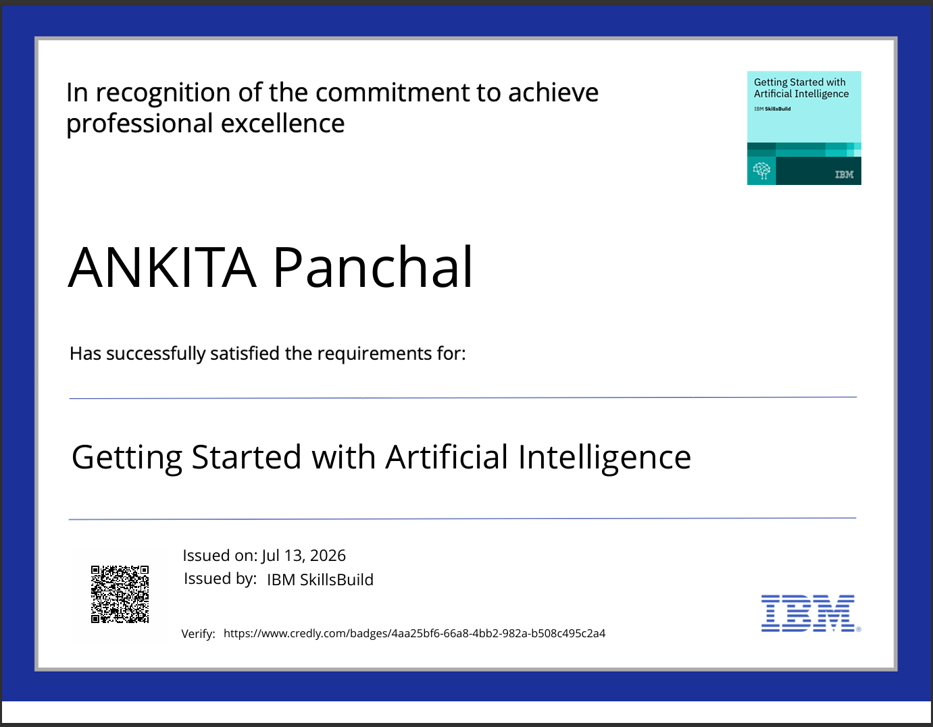
Certificates Earned:

Slide 17
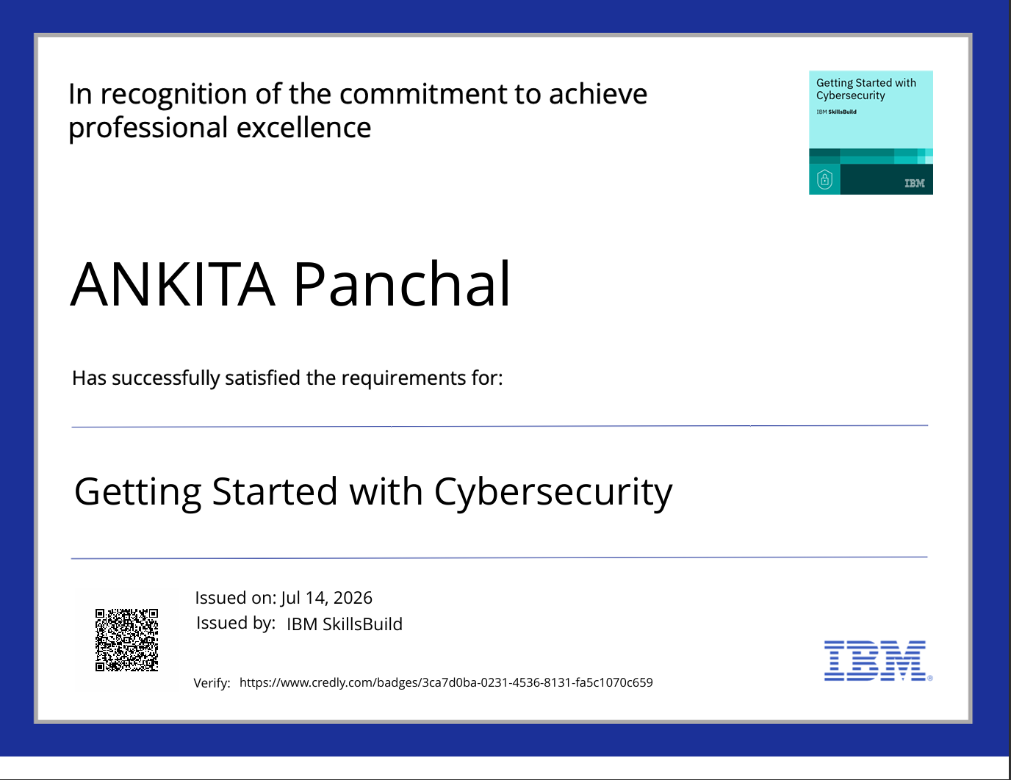
Certificates Earned:​

Slide 18
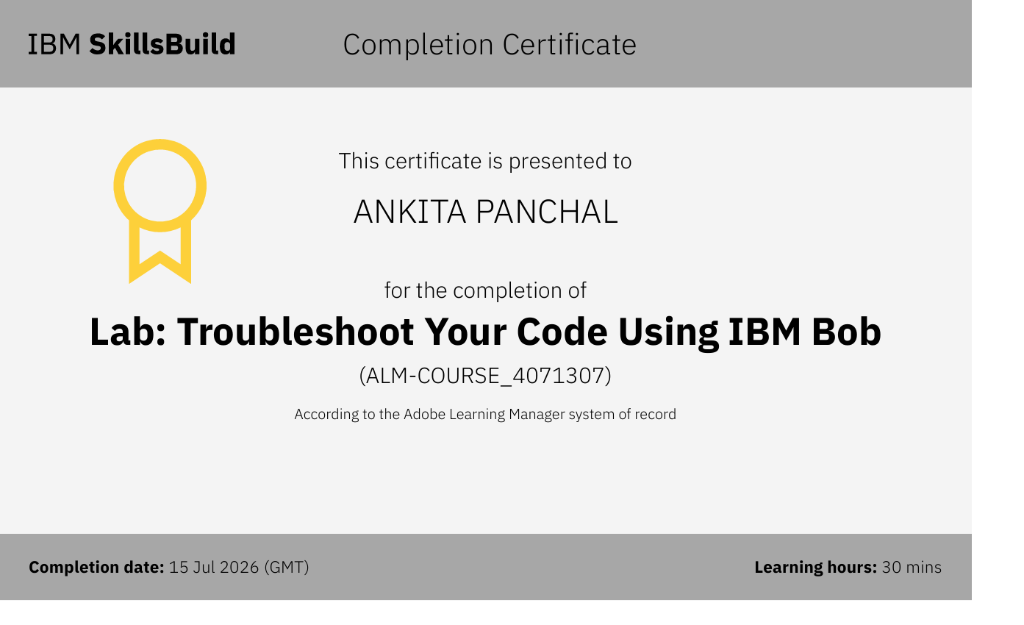
Certificates Earned:

Slide 19


